Slide 1
ITM - Xamarin introduction Juan Carlos Zuluaga Email: jzuluaga55@gmail.com Email: juanzuluaga2480@correo.itm.edu.co Twitter: jzuluga55@hotmail.com Youtube: jzuluaga55

Slide 2
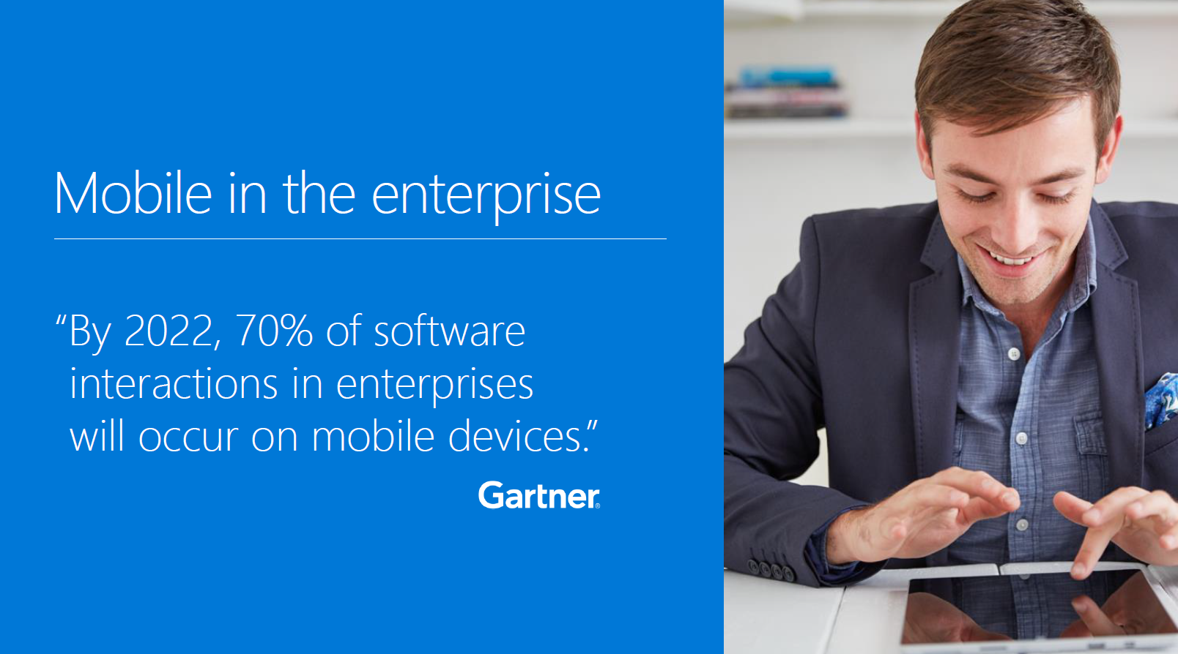
Is important Mobile?
https://localorganicrankings.com/top-10-reasons-why-mobile-technology-is-more-important-than-ever/

Slide 3
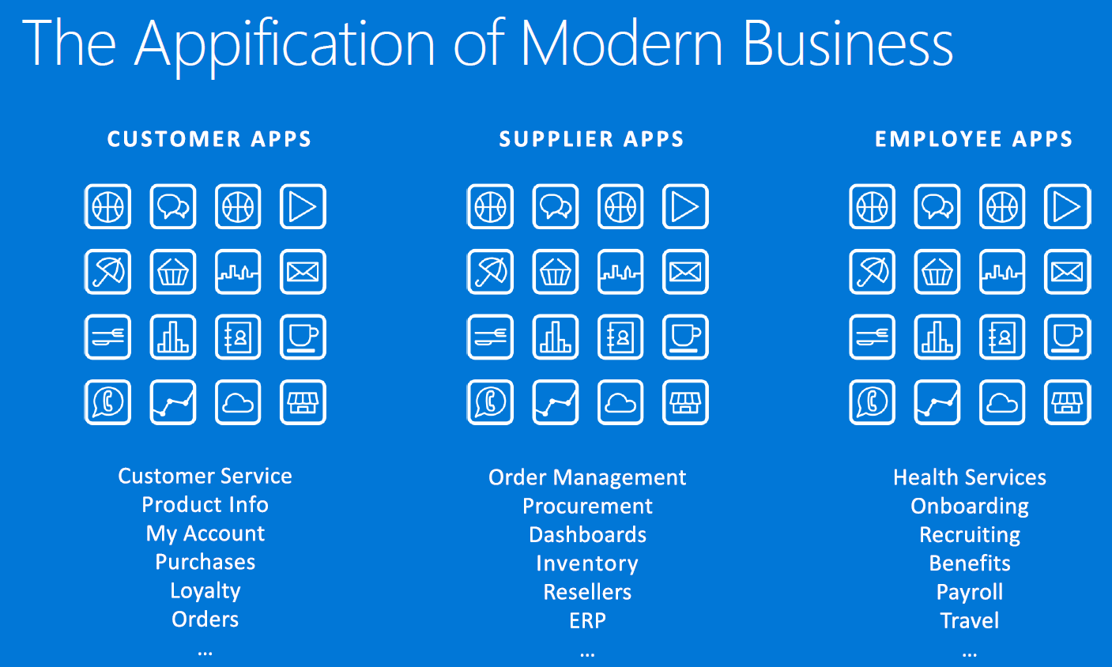
The Appification

Slide 4
Appification Challenge #1
Demand
(5 x)
Develop

Slide 5
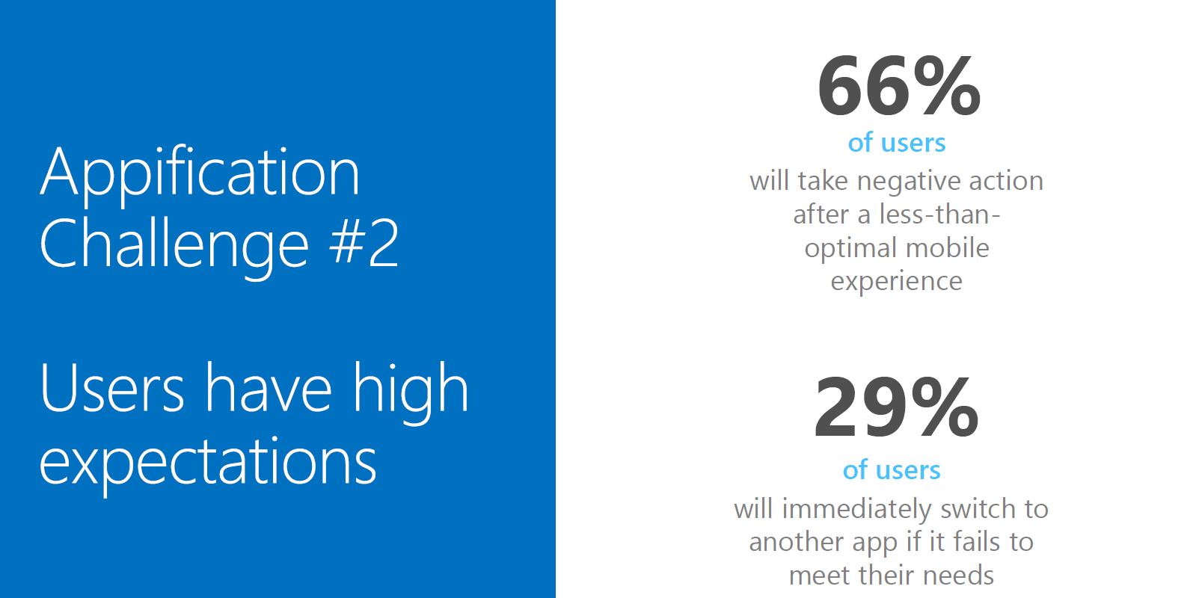
Appification Challenge #2

Slide 6
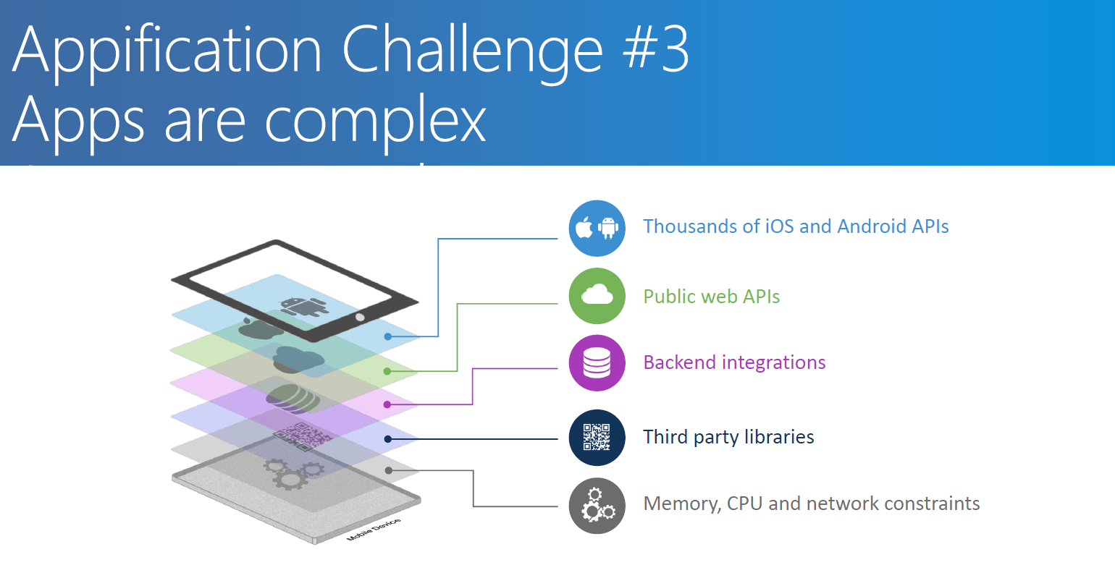
Appification Challenge #3

Slide 7
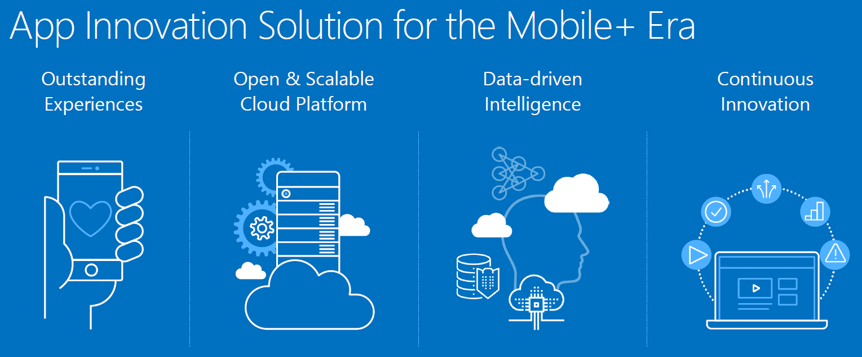
Mobile Lifecycle

Slide 8
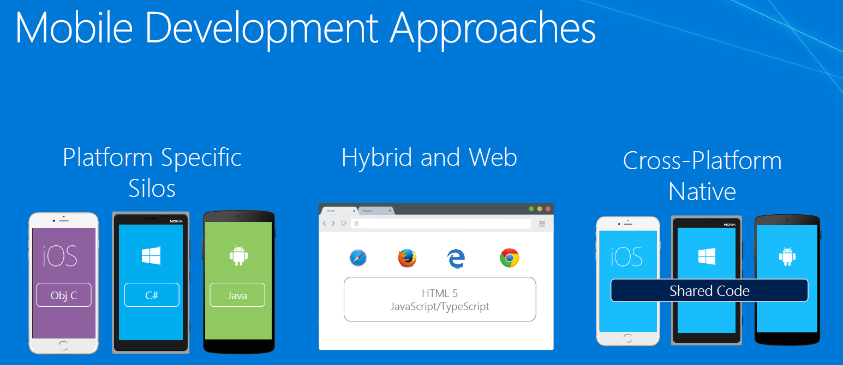
My ways?

Slide 9
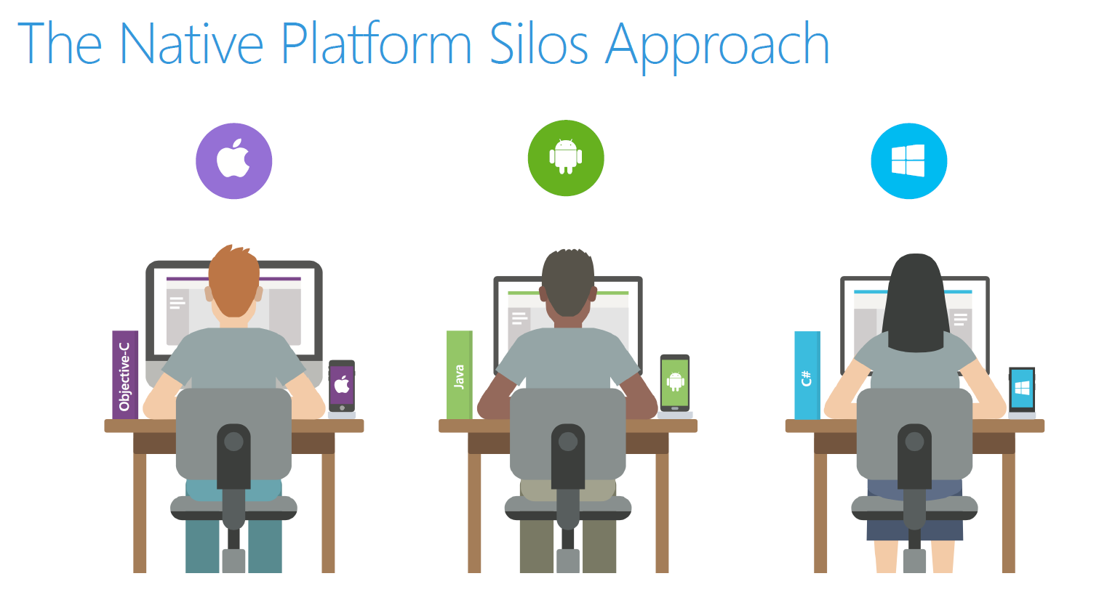
Native

Slide 10
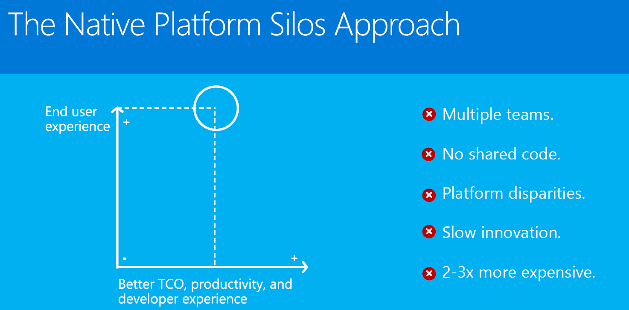
Native approach

Slide 11
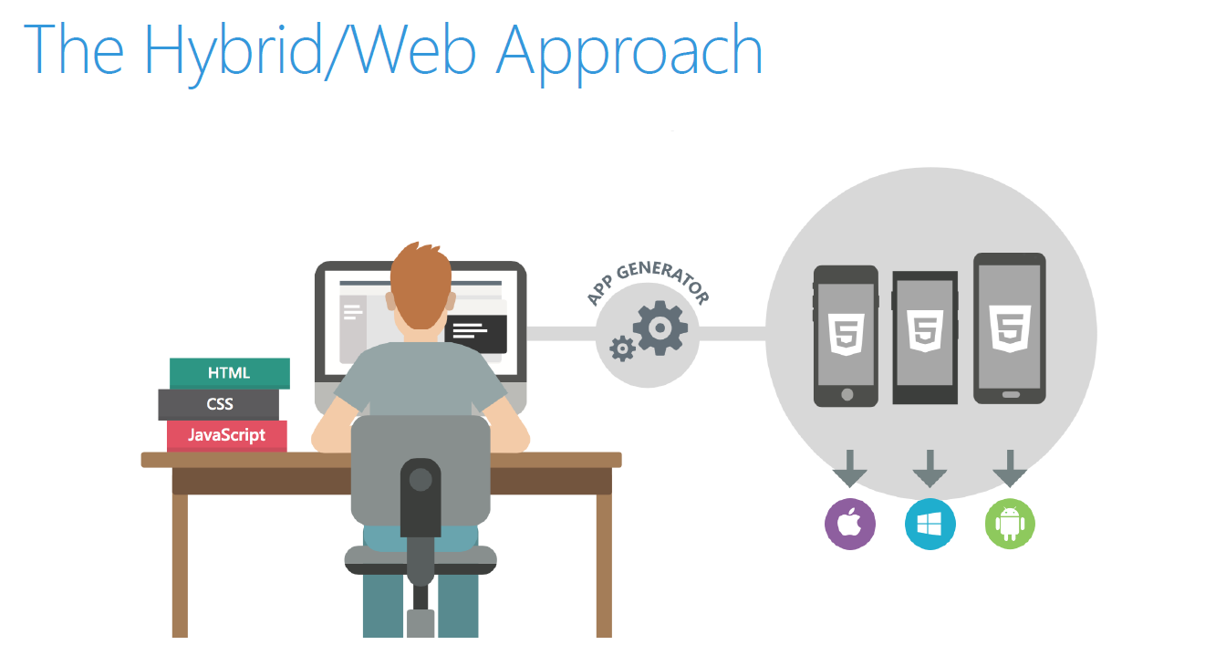
Hybrid

Slide 12
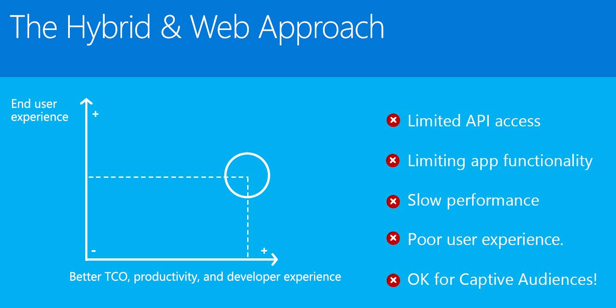
Hybrid Approach

Slide 13
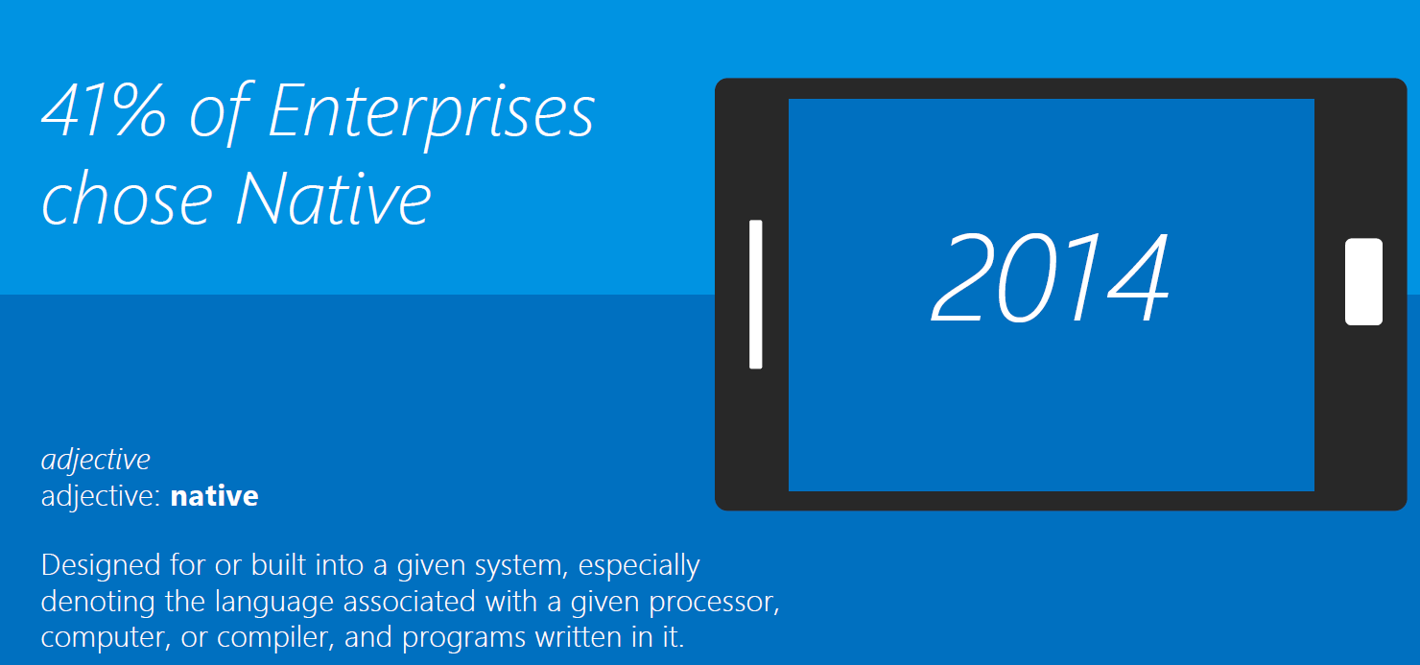
Why is native important?

Slide 14
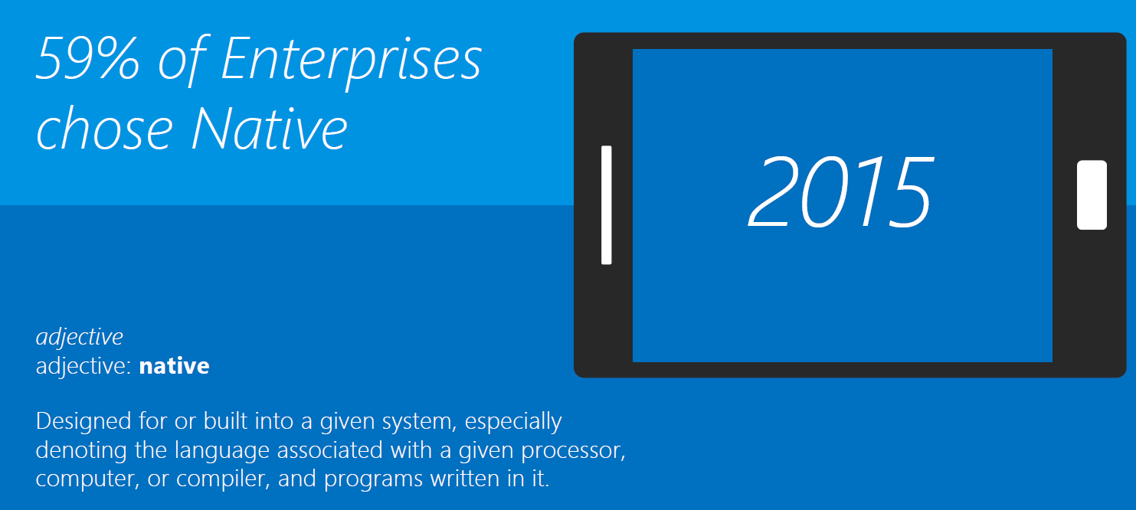
Why is native important?

Slide 15
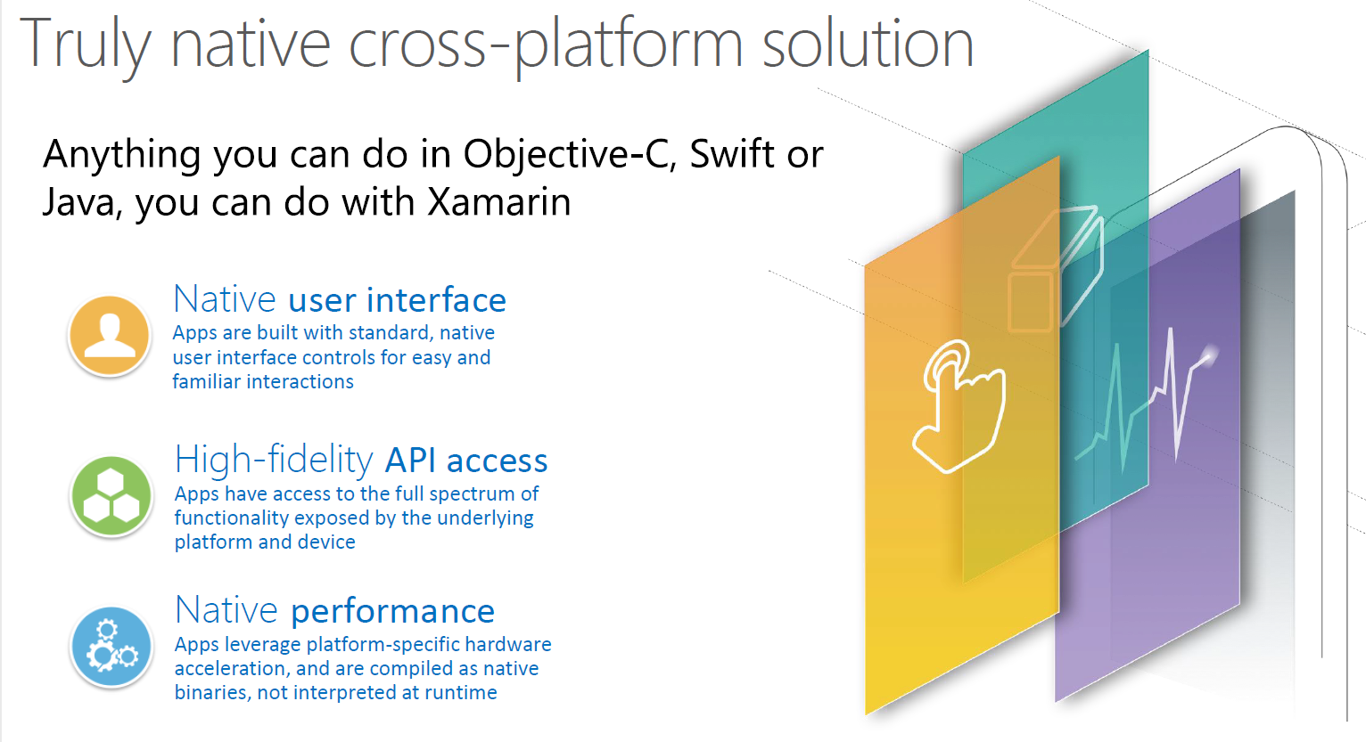
Xamarin = Truly native

Slide 16
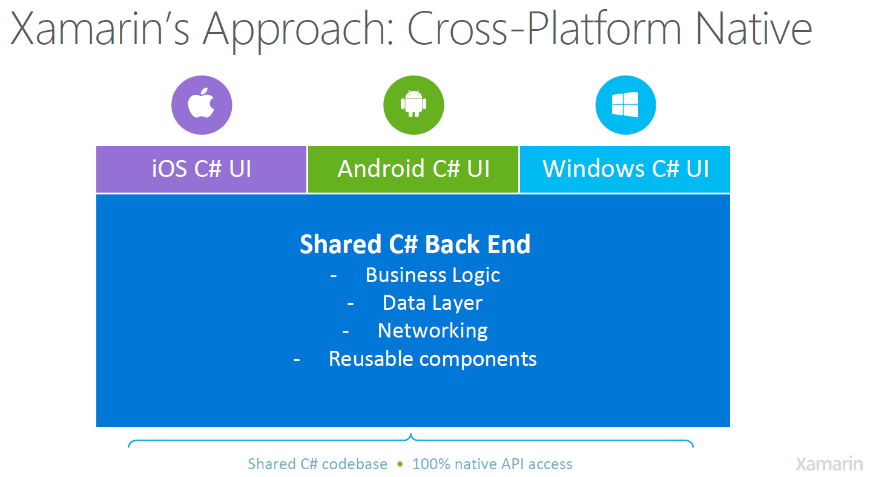
Xamarin = Share

Slide 17
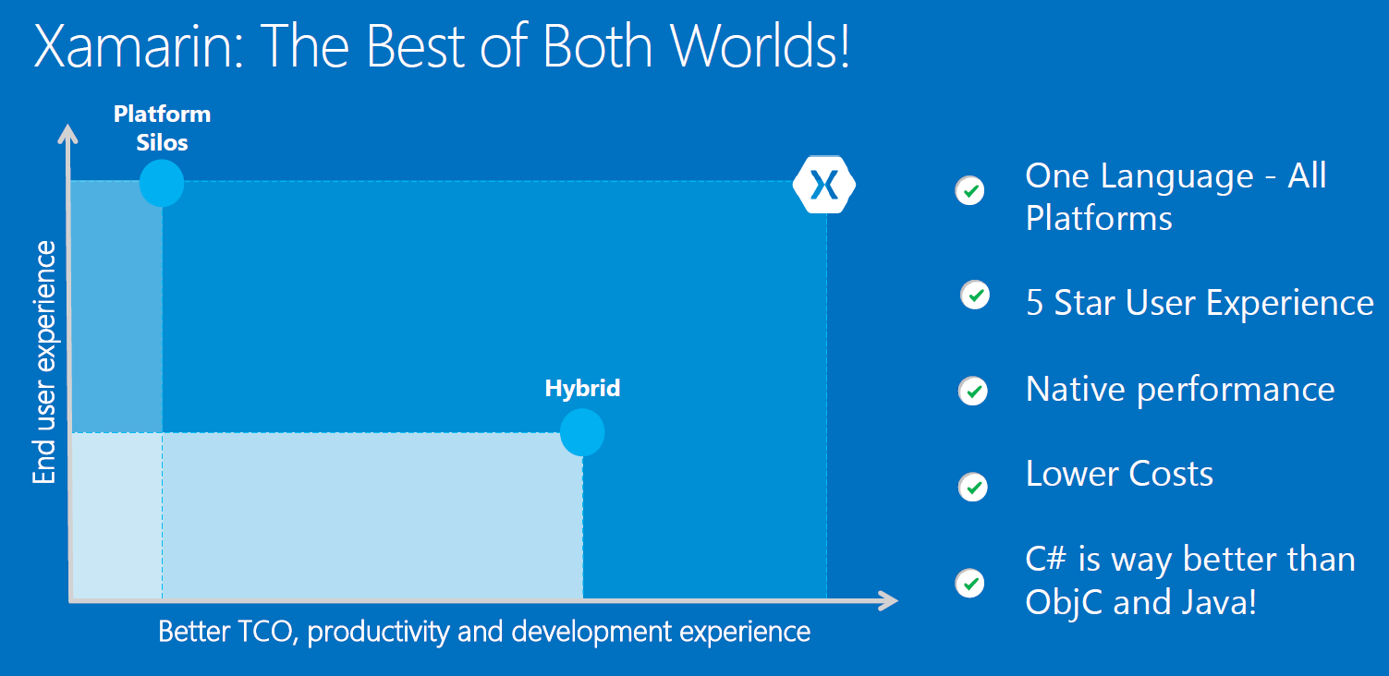
Xamarin = mix of best practices

Slide 18
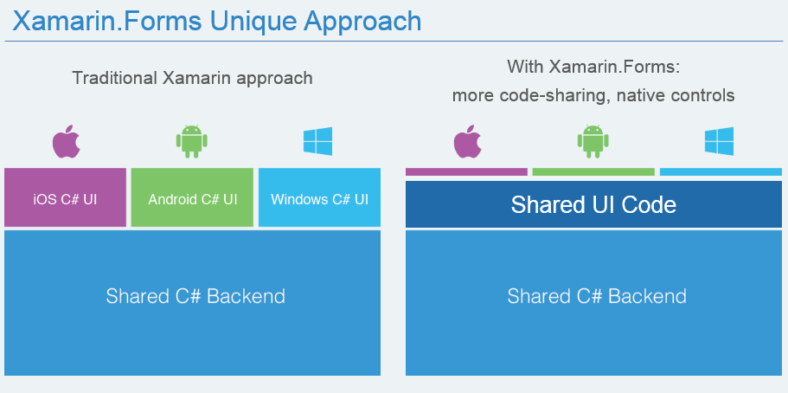
Xamarin Vs Xamarin Forms

Slide 19
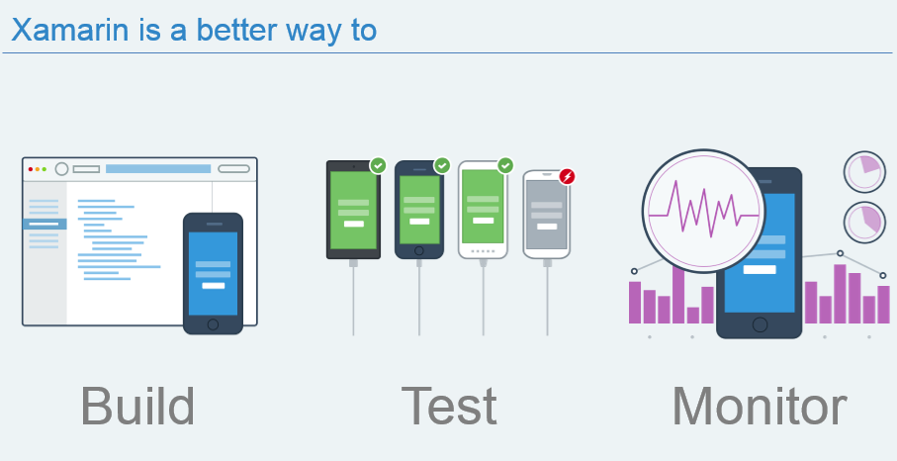
Xamarin is not only for develop

Slide 20
Ways Comparative
UX / Quality / Perform
Native
Xamarin Classic
Xamarin Forms
Hybrid solution
Cost / Time

Slide 21
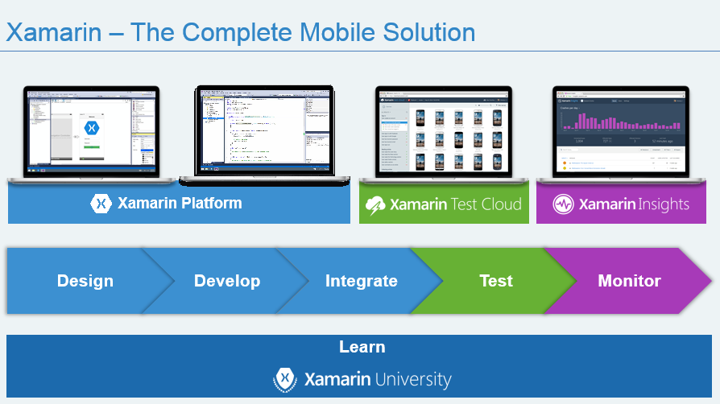
Xamarin complete suit

Slide 22
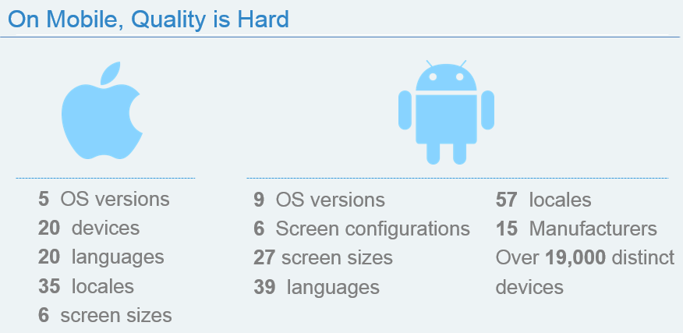
Mobile complexity

Slide 23
THANK YOU

